Slide 1

TRIBE ANALYTICS
Retail Lending- Emerging Markets
Keri Broughton, Austin Knighton, Brenden Volk, Cameron Bowden
Notes:
In these tumultuous times, the world is filled with uncertainty. What if I told you that we can help mitigate some of the unpredictability that surrounds us, and enable you to excel in the retail banking industry for decades to come.
generate supplemental income? How much should you charge? How can you ensure that you receive positive review scores? Our team set out to explore the answers to these questions.

Slide 2

Agenda
01.
Background
02.
Data
03.
Modeling
04.
Analysis
Business Problem & Goal
Cleaning & Exploration
SMOTE & Best Models
Findings & Recommendations
Notes:
I will quickly review the order of our presentation. We will cover why we choose this topic, then dive into our analysis, next we will transition into our discussion section including recommendations and close with a brief Q&A.

Slide 3


Business Problem
Executive Summary : Introduction
In recent years, U.S. banks have been expanding globally to capture untapped markets and consumer bases
Foreign markets = Higher learning curve
COVID-19 fallout
Our dataset focuses specifically on India
Notes:
We chose this dataset because it is currently the largest emerging market and the sample could help us make predictions about retail banking in the marker . Let’s look into our analysis process starting with details about our dataset.

Slide 4
Our Goal
Executive Summary : Introduction
Use the models we have created to improve U.S. retail lending in various emerging markets all over the world
Implement
Predict
Apply
Implement the models into your risk flag analysis
Use the models to ultimately predict whether or not someone will default on a loan
Apply the models to emerging markets all over the world
Notes:
We chose this dataset because it is currently the largest emerging market and the sample could help us make predictions about retail banking in the marker . Let’s look into our analysis process starting with details about our dataset.

Slide 5









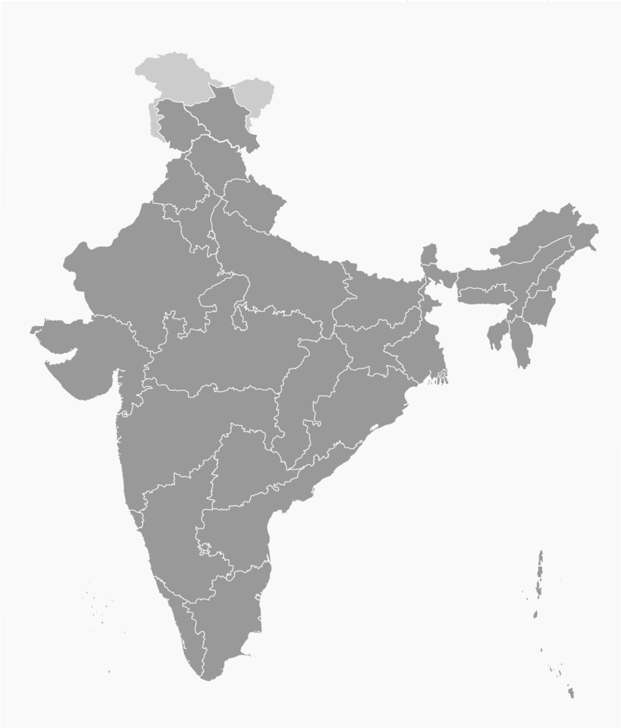


Our Dataset
Loan Application Info
 | Identification (ID) |  | Married / Single ~ Categorical
 | Income ~ Numerical |  | House Ownership ~ Categorical
 | Age ~ Numerical |  | Car Ownership ~ Categorical
 | Experience ~ Numerical |  | Profession ~ Categorical
 | City ~ Categorical |  | Current House Years ~ Numerical
 | State ~ Categorical |  | Current Job Years ~ Numerical
 | Risk Flag ~ Categorical (Yes, No)
Notes:
Thank you, Brenden. As he mentioned, our dataset focuses on the Indian market and was sourced from Kaggle. It is comprised historical data gathered at the time of the loan application. These 12 attributes are values captured in the application. Potential borrowers must disclose their income, age, work history experience in years, city, state(based in India), marital status, house and car ownership, profession, current years in home and job. Each application is then assigned whether they (which is no they didn’t default, and yes they defaulted on a loan).
SOme of the attributes are numerical and some are categorical. These are the attributes that we will use to build an effective model.

Slide 6
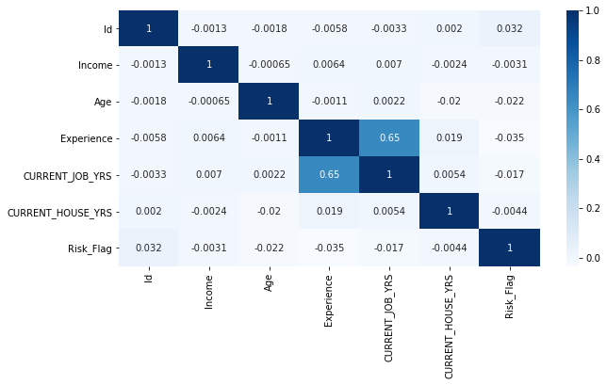
Correlation Matrix
Pre-cleaning
Multicollinearity
Indicates that all variables have a low correlation with the risk flag …… why?
Notes:
As we pulled our data in we wanted a quick visual to see how our variables correlated with each other and risk flag. This would be helpful for our cleaning. First, we noticed that the categorical variables needed to be converted into numerical variable and are therefore missing here. There’s multicollinearity present between current job years and years of experience. And we also noticed that all of the attributes listed have low correlation with the risk flag. We will take a look at this again once it includes our converted categorical variables.

Slide 7
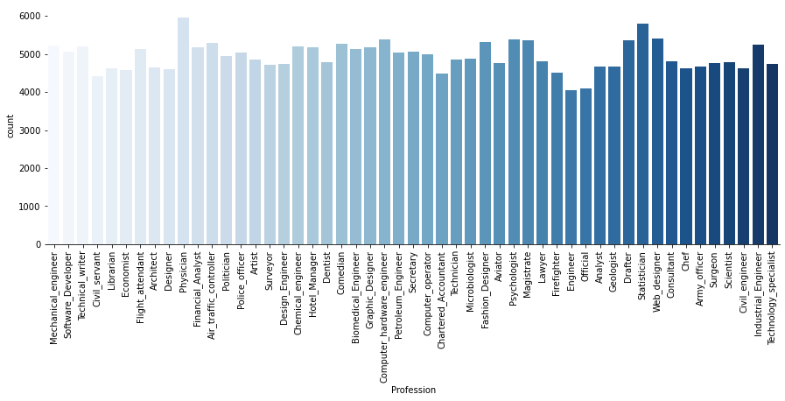
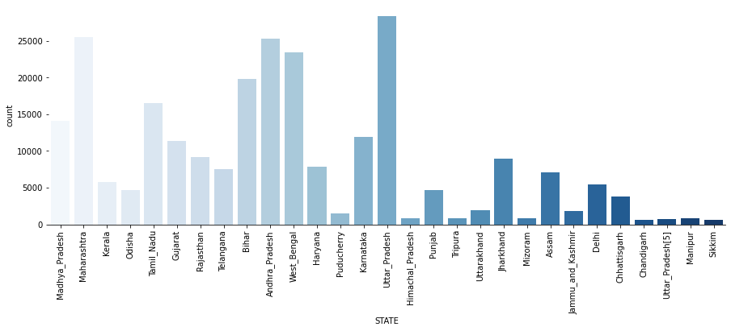
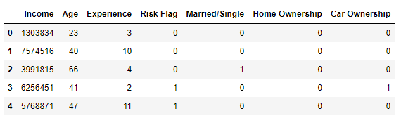
Data Cleaning
Remove multicollinearity
“Current Job Years” & “Experience”
Remove categorical variables with many unique values
Dummy code categorical variables
Notes:
So we cleaned the data: removed multicollinearity, removed categorical variables with many unique values. As you can see here for example, Profession and state had quite a few unique values that would not be helpful in determining attributes that predict likelihood of default. If the number of levels of categorical variable is very large, it is not suitable for a classification model. As the number of features grows, the amount of data we need to accurately be able to distinguish between these features (in order to give us a prediction) and generalize our model grows EXPONENTIALLY. We also dummy coded our variables. In total we removed 6 columns and converted 3 categorical variables.

Slide 8
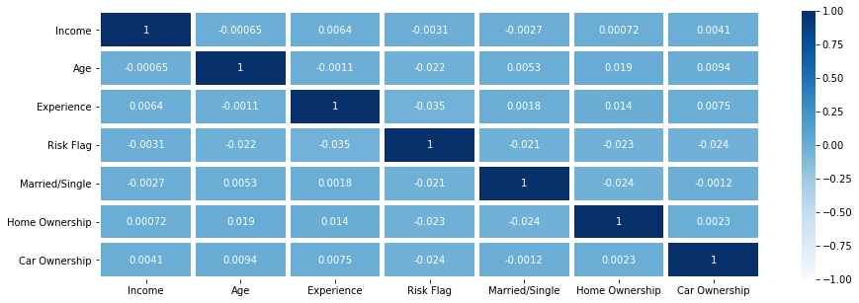
Correlation Matrix
Post - cleaning
Includes categorical variables
Excludes multicollinearity
Correlation with risk flag is still low …. Why?
Notes:
Now that we have clean data, let’s take a look at our correlation matrix again. There’s no multicollinearity and it includes our dummy coded categorical variables, yet the correlation with the risk flag is still very low for all of the attributes. Let’s take a closer look through exploration

Slide 9
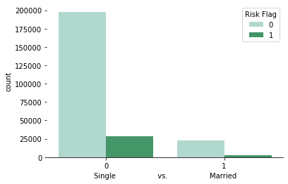
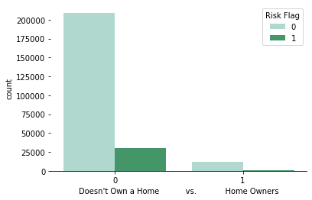
Data Exploration
Single vs Married
Non-Home Owner vs Home Owner
Married borrowers are less likely to default
Home owners are very slightly less likely to default
12.4%
12.5%
8.9%
11.4%
Although, the correlation shows insignificant correlation with the risk flag, we can identify some patterns, quick insight, and problems through data exploration.
Notes:
Although, the matrix showed low correlation associated with the risk flag, we can identify a few patterns in our data. To the left, you can see that married borrowers are less likely to default. To the right you can see that home ownership slightly makes a difference but in the level of default.

Slide 10
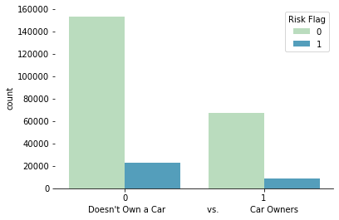
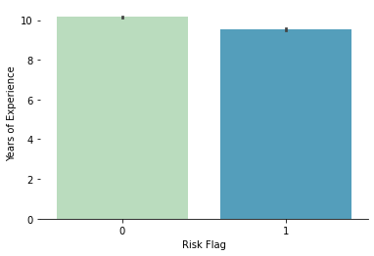
Data Exploration
Non-Car Owner vs Car Owner
Years of Experience & Risk Flag
Borrowers with more work experience are slightly less likely to default!
Non-car owners are slightly more likely to default!
12.5%
11%
Notes:
Again, we can see that car ownership is less likely to default but only slightly. Borrowers who default tend to have slightly fewer years of work experience. Based on our dataset this is only a minor difference.

Slide 11
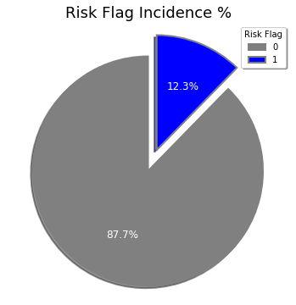
Imbalanced Data
Low incidence of target variable
Low collinearity with risk flag due to low incidence
Imbalanced data will need to be addressed prior to modeling
Notes:
Now that we’ve explored the data, we have a better understanding of the attributes within our dataset. But in order to help you predict whether a customer is likely to default or not, we need to know why we are seeing such low correlations with the risk flag and how this may impact our models. As you can see, the risk flag incidence is only 12% of our data. We have an imbalance dataset. This is why we saw low correlations. We will need to fix this to be able to build a useful model and identify the most significant attributes. With that being said, I will turn it over to my colleague, Cameron.

Slide 12
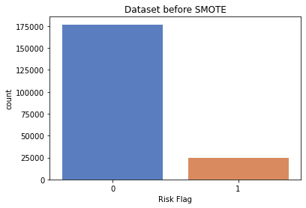
Data Modeling
Zack Slide (Visuals)
Stratification
StandardScaler
Defaulters 12.3%
Notes:
30479 rows as starting point, now down to 29592
Address removed completely from the start that were no Value (address and
First look at Data set, it seemed perfect. As the course progressed and we became more savvy second opinion. (30479) start
Our main identifier is our unit of Analysis, Host ID.
Look out our numeric variables. 4 numeric Beds, Price, # of reviews, Review Rating Score. Pretty Solid.
As developing Hypothesis, they started to look lacking.
Plus one, create Number of Days Variable (IV H3) capturing how long someone was a host.
Our eyes wandered to categorical variables, these could be pretty useful! Let's do a conversion….
Property type, Dummy coded as Apt versus other (IV H2)
Neighborhood, DC as 0-4 to capture the boroughs of NY (IV HI)
Room Type, DC as 0-2 to capture Entire Home/APT, Private Room, Shared Room (IV H4)
Remaining Categorical while not IV or DV do have bearing
Book ends, start date of host and end date to create Number of Days
Creation of Review Score Bins bad (0-90), good (91-95), great (96-99), and excellent (100).
Row Identifier (already discussed as our unit of analysis, Host ID
Compass, zip code…. We'll talk more about that one on the next slide.

Slide 13
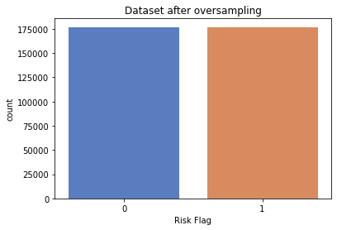
Data Modeling
Zack Slide (Visuals)
SMOTE Oversampling
What is SMOTE?
Why SMOTE?
Notes:
30479 rows as starting point, now down to 29592
Address removed completely from the start that were no Value (address and
First look at Data set, it seemed perfect. As the course progressed and we became more savvy second opinion. (30479) start
Our main identifier is our unit of Analysis, Host ID.
Look out our numeric variables. 4 numeric Beds, Price, # of reviews, Review Rating Score. Pretty Solid.
As developing Hypothesis, they started to look lacking.
Plus one, create Number of Days Variable (IV H3) capturing how long someone was a host.
Our eyes wandered to categorical variables, these could be pretty useful! Let's do a conversion….
Property type, Dummy coded as Apt versus other (IV H2)
Neighborhood, DC as 0-4 to capture the boroughs of NY (IV HI)
Room Type, DC as 0-2 to capture Entire Home/APT, Private Room, Shared Room (IV H4)
Remaining Categorical while not IV or DV do have bearing
Book ends, start date of host and end date to create Number of Days
Creation of Review Score Bins bad (0-90), good (91-95), great (96-99), and excellent (100).
Row Identifier (already discussed as our unit of analysis, Host ID
Compass, zip code…. We'll talk more about that one on the next slide.

Slide 14
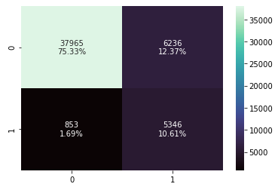
Decision Tree
Zack Slide (Visuals)
Model
Minimize False Negatives
Maximize True Positives
Scoring
Accuracy - 86%
Recall - 86%
Validation
GridSearchCV
Threshold Manipulation - 0.3
Notes:
30479 rows as starting point, now down to 29592
Address removed completely from the start that were no Value (address and
First look at Data set, it seemed perfect. As the course progressed and we became more savvy second opinion. (30479) start
Our main identifier is our unit of Analysis, Host ID.
Look out our numeric variables. 4 numeric Beds, Price, # of reviews, Review Rating Score. Pretty Solid.
As developing Hypothesis, they started to look lacking.
Plus one, create Number of Days Variable (IV H3) capturing how long someone was a host.
Our eyes wandered to categorical variables, these could be pretty useful! Let's do a conversion….
Property type, Dummy coded as Apt versus other (IV H2)
Neighborhood, DC as 0-4 to capture the boroughs of NY (IV HI)
Room Type, DC as 0-2 to capture Entire Home/APT, Private Room, Shared Room (IV H4)
Remaining Categorical while not IV or DV do have bearing
Book ends, start date of host and end date to create Number of Days
Creation of Review Score Bins bad (0-90), good (91-95), great (96-99), and excellent (100).
Row Identifier (already discussed as our unit of analysis, Host ID
Compass, zip code…. We'll talk more about that one on the next slide.

Slide 15
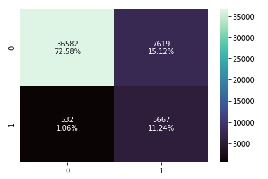
Random Forest
Zack Slide (Visuals)
Model
Minimize False Negatives
Maximize True Positives
Scoring
Accuracy - 86%
Recall - 86%
Validation
GridSearchCV
Threshold Manipulation - 0.3
Notes:
looking at the confusion matrix. First highlighted in green are the true or accurate predictions from the models, where the blue boxes are false predictions. Starting at the top left is the models true predictions of non defaulters. The top right is the false predictions of a defaulter. The bottom left is the false prediction of a non defaulter and the bottom right is the true prediction of defaulters.

Slide 16
Comparing Models
Implications & Limitations
Brenden (Visuals)
DISCUSSION
Random Forest Classifier
Decision Tree Classifier
Expected Non Defaulters
Unexpected Non Defaulters
Expected Non Defaulters
Unexpected Non Defaulters
Unexpected Defaulters
Expected Defaulters
Unexpected Defaulters
Expected Defaulters
Captures 91% of all Defaulters
Captures 88% of all Defaulters

Slide 17
Comparing the Savings
Implications & Limitations
Brenden (Visuals)
DISCUSSION
Net Savings from RFC Model
Conversion Rate
Rupees | 1.00
Conversion Rate | 0.01333
Dollars | $0.01
Average Loan and Interest Rate in India
Average consumer loan in USD | $1331.67
Average interest rate | 9.15%
Net Savings / (Loss)
Number of Unexpected Defaults | 532
Loss Given Unexpected Defaults | $ (836,096.46)
Number of Missed Loans | 7619
Loss Given # of Missed Loans | $ (914,062.41)
Number of Expected Defaults | 5667
Savings of Expected Defaults | $ 8,906,313.21
Net Savings | $ 7,156,154.34
*Assumption: Two year period (typical delinquency period starts at 6 months) This does not include acquisition costs, potential cross product purchases, and more.
Net Savings from DT Model
Conversion Rate
Rupees | 1.00
Conversion Rate | 0.01333
Dollars | $0.01
Average Loan and Interest Rate in India
Average consumer loan in USD | $1331.67
Average interest rate | 9.15%
Net Savings / (Loss)
Number of Unexpected Defaults | 853
Loss Given Unexpected Defaults | $ (1,340,583.23)
Number of Missed Loans | 6236
Loss Given # of Missed Loans | $ (748,141.91)
Number of Expected Defaults | 5346
Savings of Expected Defaults | $ 8,401,826.44
Net Savings | $ 6,313,101.30
Difference of $843,053 between the two models

Slide 18
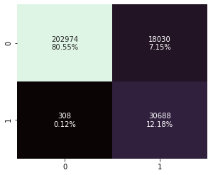
Best Model
Implications & Limitations
Brenden (Visuals)
DISCUSSION
Random Forest Classifier
Net Savings from Best Model
Number of Unexpected Defaults | 308
Loss Given Unexpected Defaults | $ (484,055.84)
Number of Missed Loans | 18030
Loss Given # of Missed Loans | $ (2,163,085.09)
Number of Expected Defaults | 30688
Savings of Expected Defaults | $ 48,229,564.09
Net Savings | $ 45,582,423.16
Significant Attributes
 | Income ~ 57%
 | Age ~ 26%
 | Experience ~ 14%
Expected Non Defaulters
Unexpected Non Defaulters
Unexpected Defaulters
Expected Defaulters
Captures 97% of Importance
Captures 99% of all Defaulters

Slide 19



DISCUSSION
Implications & Limitations
FINDINGS
LIMITATIONS
RECOMMENDATIONS
Random Forest was the best model
99% of all defaulters
Statistical Significance
Income
Age
Experience
Only represents Indian Market
Does present missed opportunities for New Customers
Personalized Financial Literacy Education
Implement Our Model for Cost Savings and Risk Mitigation with over $45 Million in Savings

Slide 20

QUESTIONS
Recommendations

Slide 21
THANK YOU!
tribe_analytics@email.wm..com
555.555.5555
tribeanalytics.com

